Slide 1

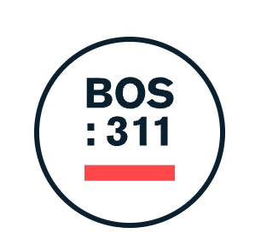
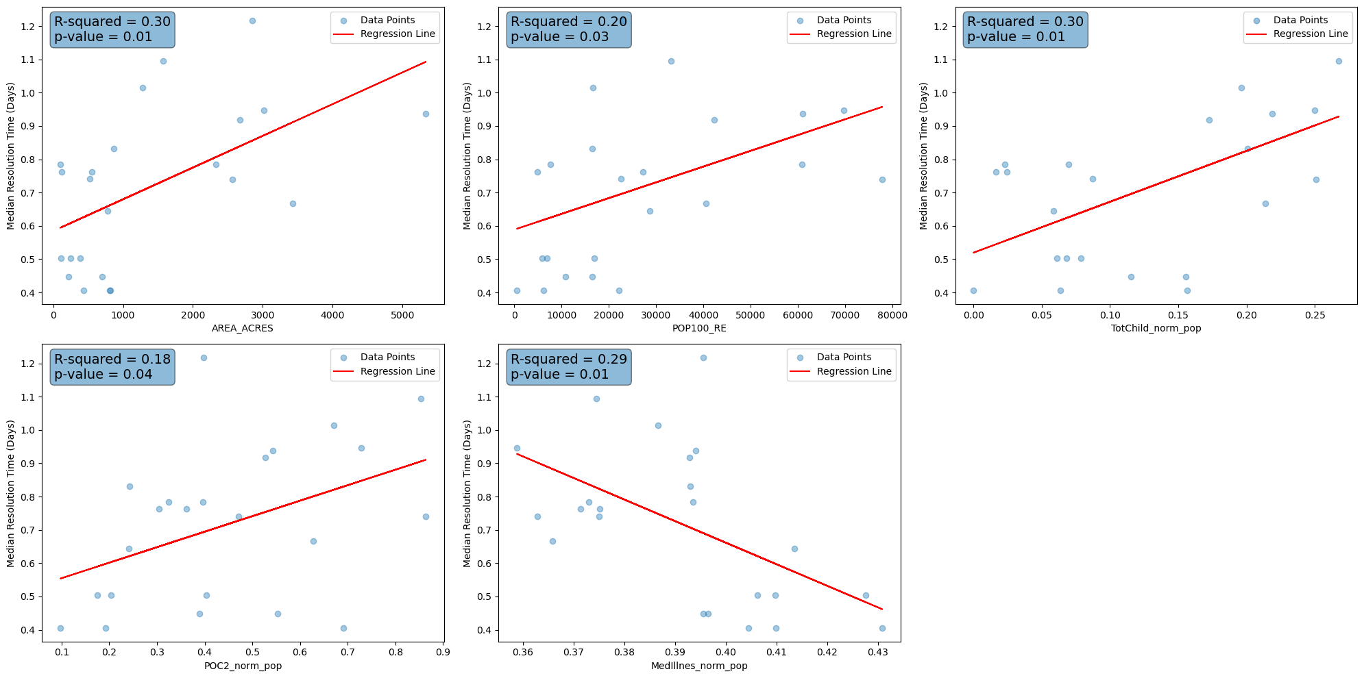
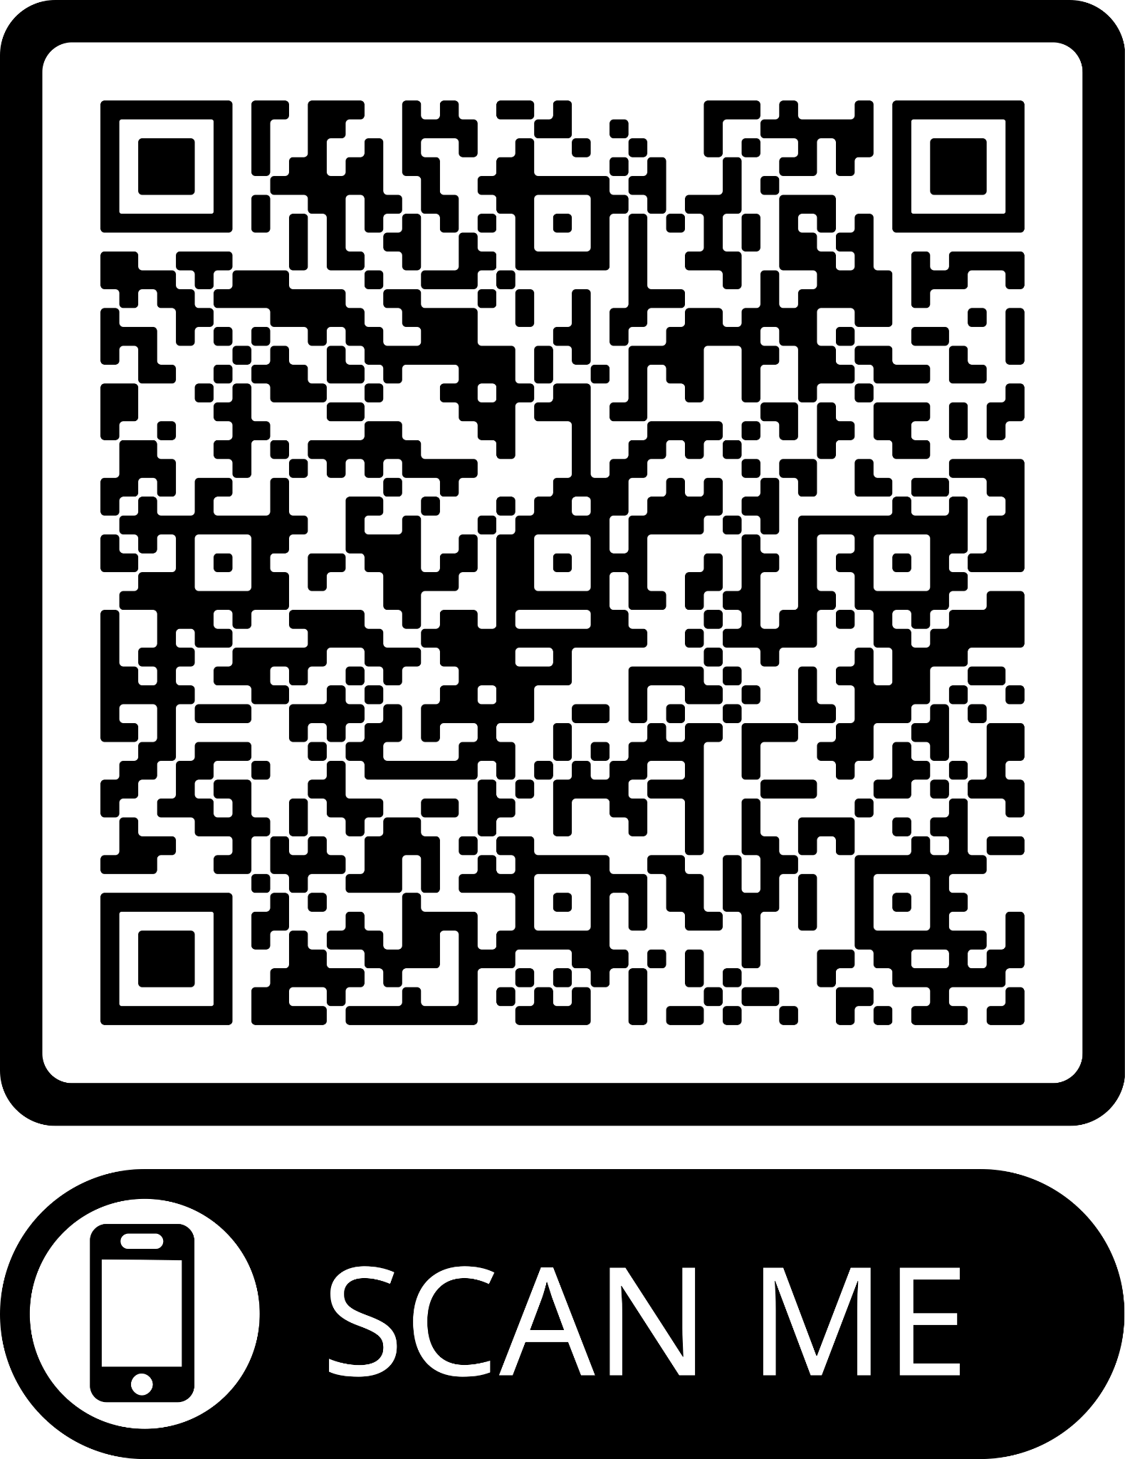
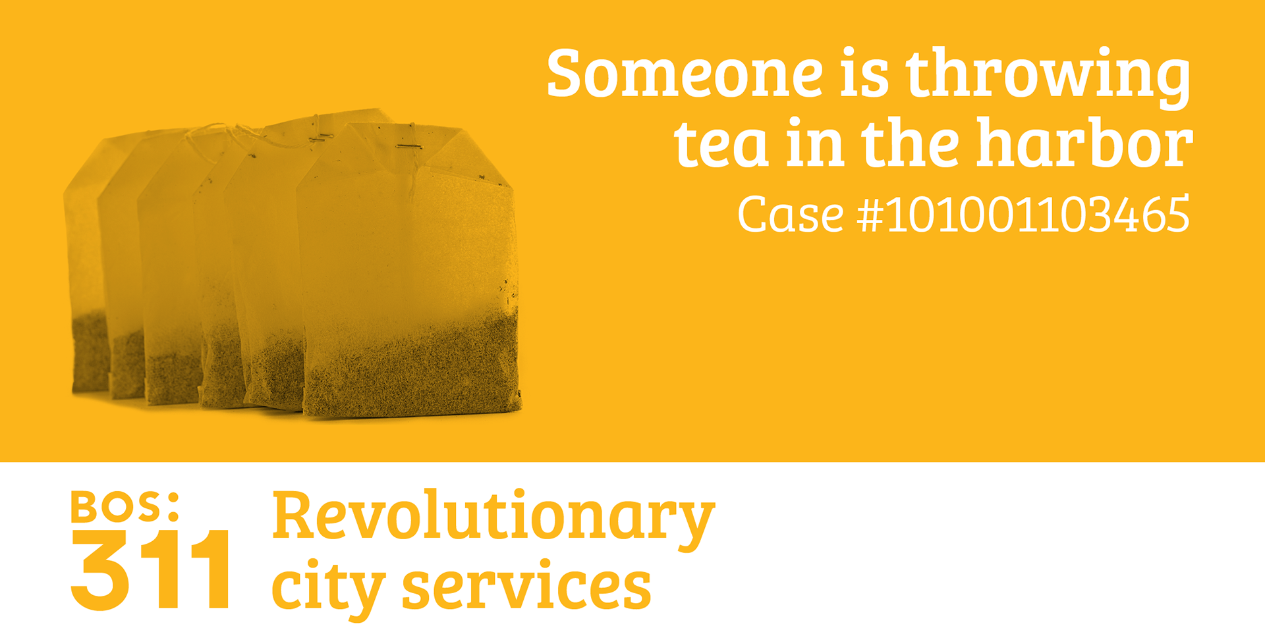
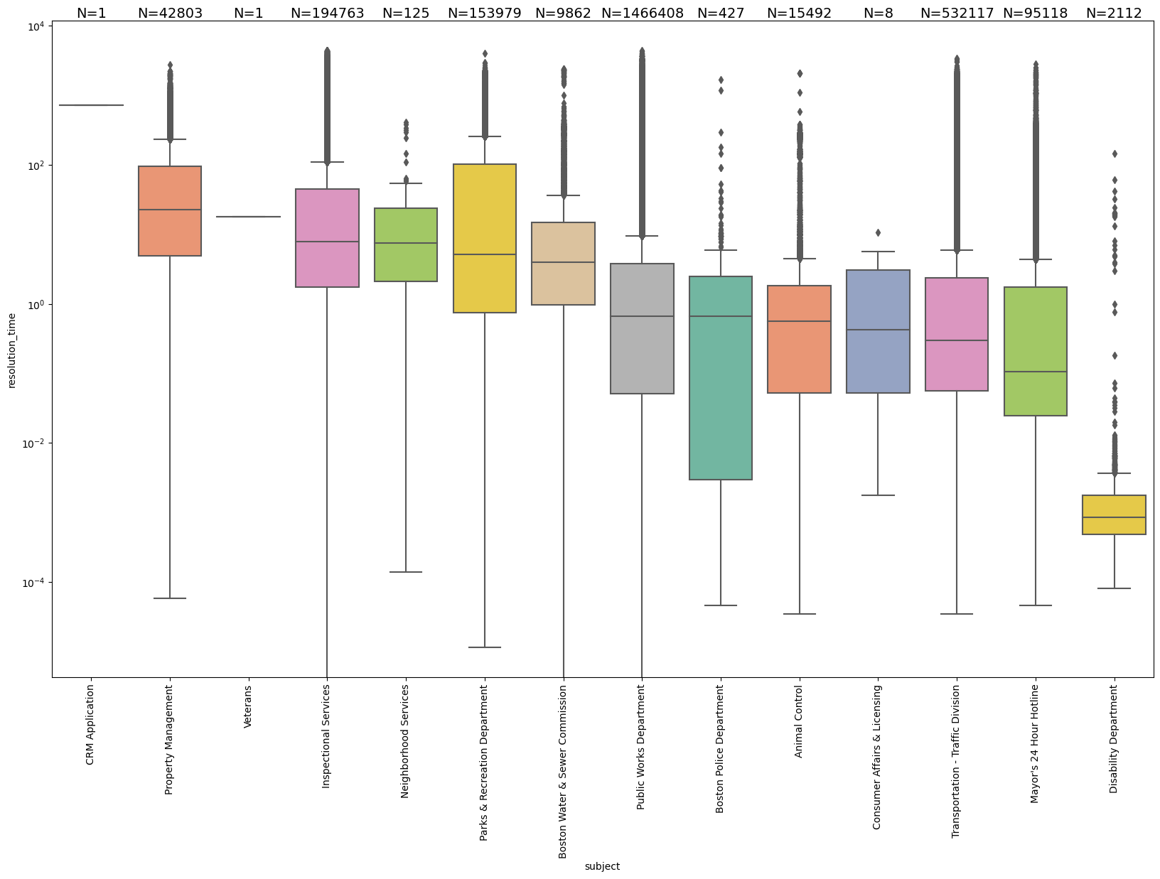

CS 506 CITY of BOSTON 311
Raul-Fikrat A., Mahdi K., Rohan A., Gersian C., Laerk N.
Project Summary
Goal: To establish a comprehensive
historical database for the City of Boston's 311 services.
Key Questions:
Are the Boston 311 services equitable and efficient?
How can we best facilitate informed decision-making with our analysis?
Process / Methods / Tech Stack
Analysis Tools: Python, pandas, Seaborn, Scikit Learn, statsmodels, Ipywidgets, numPy, PyTorch
Project Results
Correlations with Social Vulnerability (Equitability)
The factors below have significant effects on the median resolution time.
Resolution Times Across Departments (Efficiency)
Some departments, are less efficient than others in terms of median resolution.
PowerBI Report/ Base Project:
What is 311?
The 311 service is a
non-emergency
hotline designed to
provide residents
and with a way to access information about
city services, report issues, and seek assistance with matters like reporting potholes, requesting trash cleanups, etc.
Conclusions & Reflections
Efficiency might be lacking across some departments.
We found that median resolution time increased with larger areas, and higher populations which is expected. Areas with a higher proportion of POC, and children, exhibit significantly higher median resolution times. On the other hand, areas with higher medically illness proportion tend to experience lower median resolution times.
Interactiveness has been instrumental in identifying trends in data.
Learned to apply new tools such as PowerBI, GitHub, ipywidgets, etc.
Communication, and teamwork are key!
Clients & Mentors
Client: City of Boston 311
TPM: Bella Davies
Partners: BU SPARK!

